Slide 1
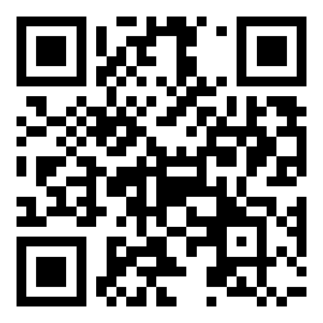
From Crisis to Opportunity: A Google Trends Analysis of Global Interest in Distance Education Tools During and Post the COVID-19 Pandemic
Priyanga Dilini Talagala
Senior Lecturer
Department of Computational Mathematics
University of Moratuwa, Sri Lanka
June 28, 2024
Slides available at

Slide 2







Data and codes available at: https://github.com/pridiltal/CARMA2024_Analysis
Slides available at: prital.netlify.app
This work was supported in part by the RETINA research lab, funded by the OWSD, a program unit of the United Nations Educational, Scientific, and Cultural Organization (UNESCO).
Priyanga Dilini Talagala
PhD (Monash)
prital.netlify.app
pridiltal
Thiyanga S. Talagala
PhD (Monash)
thiyanga.netlify.app
thiyangt

Slide 3
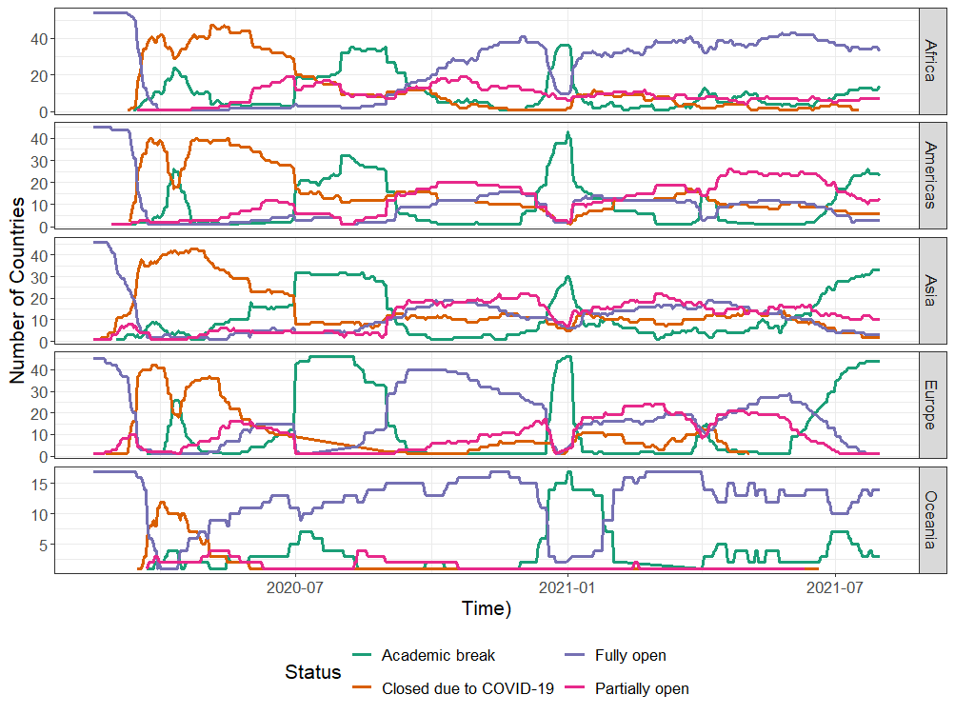
Region wise tracking of COVID-19 caused school closures and re-openings
Source: UNESCO (2020). COVID-19 educational disruption and response. [Online; accessed 13-May-2020]. https://en.unesco.org/covid19/educationresponse
Notes:
As we all know COVID 19 pandemic is one of the most impactful events of the 21 st centurary.
Among many sectors, education is one of the most affected sectors by COVID 19 Pandemic
This figure shows the evolution of region wise school closures and reopenings due to the COVID 19 Pandemic
The Orange line here represents the school closures due to covid 19 pandemic.
We can see that with the start of the Pandemic there is a near total closure of schools all around the world

Slide 4

From chalk-talk to virtual walk
Notes:
The speed of these school closures demanded a rapid move from chalk talk to virtual walk,
A rapid shift from traditional classroom teaching to online learning.

Slide 5
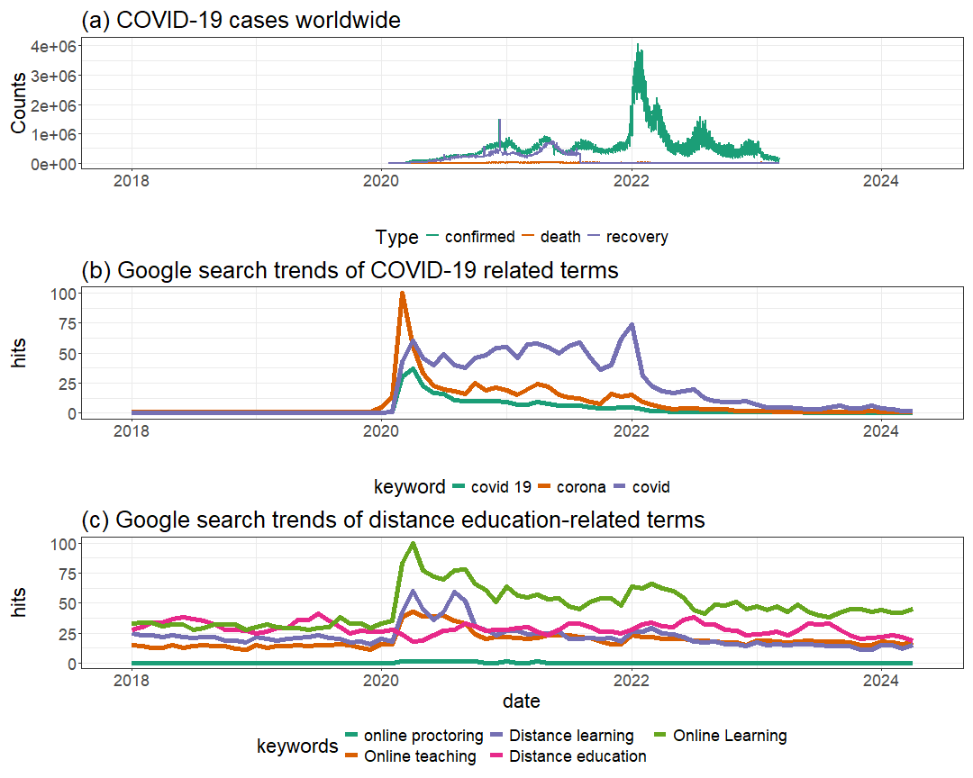
Notes:
But we all know that distance education has a long history.
However, COVID 19 made a new Era of distance education.
Because during this pandemic every single step including, planning, developing new tools and techniques, conducting awareness programs about online learning, shifting towards online learning , everything happened online, due to the unexpected massive global shutdown.
This lack of experience, lack of awareness, lack of rediness cased millions of distance education related internet searched during the COVID 19 pandemic.
This shows the …. B)….. C)
We can see that both these google search trend spikes coincide with increasing COVID 19 cases, even though distance education has a long history before covid 19.

Slide 6
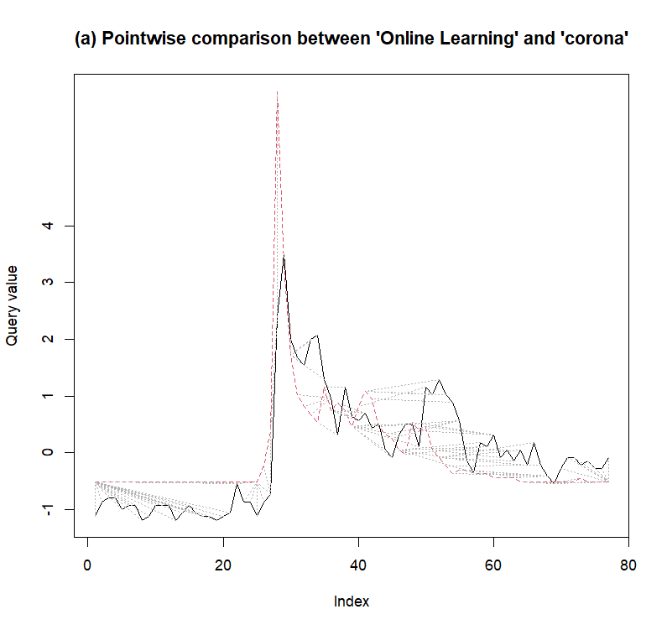
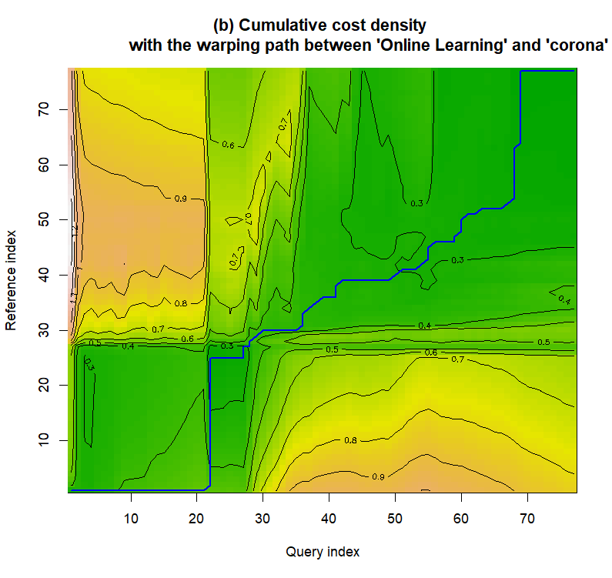
Dynamic Time Warping (DTW) Analysis
Corona
Online Learning
2018
2020
2022
2024
2018
2020
2022
2024
Notes:
This correlation between COVID 19 and distance education is further confirmed by the DTW
This shows the pairwise comparison between the two terms, online learning and corona, That’s the term we used in the early stages of the pandemic
We can see a clear change in the search patterns before and after the Covid 19 pandemic.
This shows the cumulative ….
If the blue line has a 45 degrees angle it indicated a strong similarity and alignment over time
Horizontal or vertical lines show areas of dissimilarity.
This graph shows a strong similarity between the two search terms in the early stages of the pandemic.

Slide 7
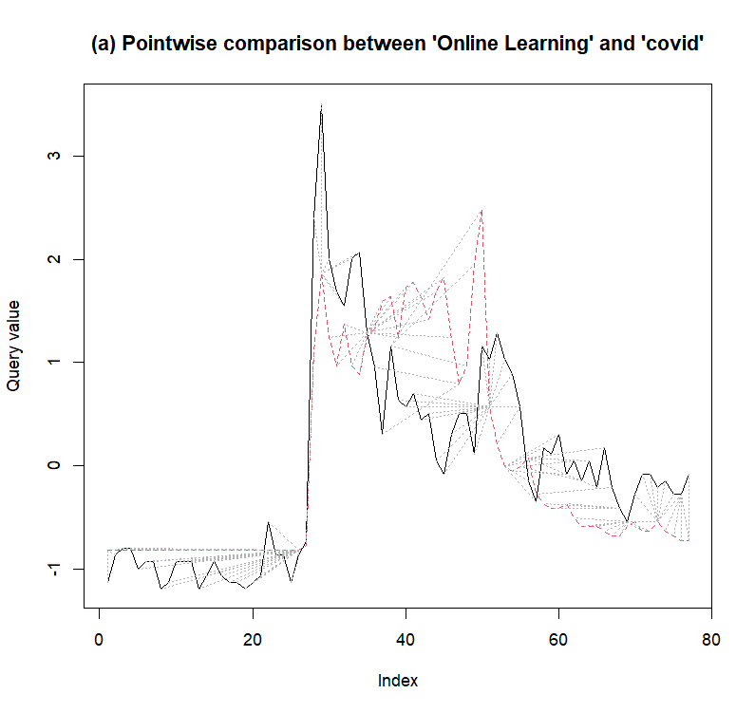
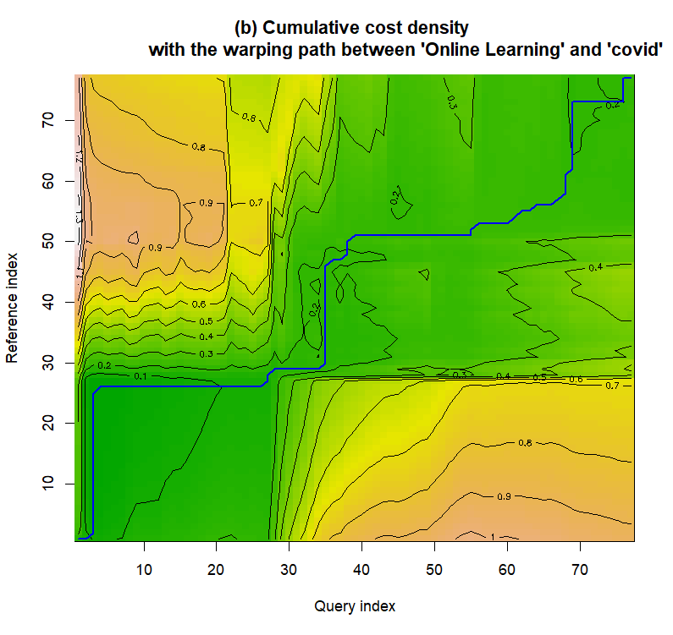
Dynamic Time Warping (DTW) Analysis
Online Learning
COVID
2018
2020
2022
2024
2018
2020
2022
2024
Notes:
Then we started using the term covid instead of corona around 2022
This changes influenced the alignment between the two terms .
Only after we introduced the term CVOID 19 , we see a similarity between those two search terms.
This further confirms the relationship between COVID 19 and distance learning.

Slide 8
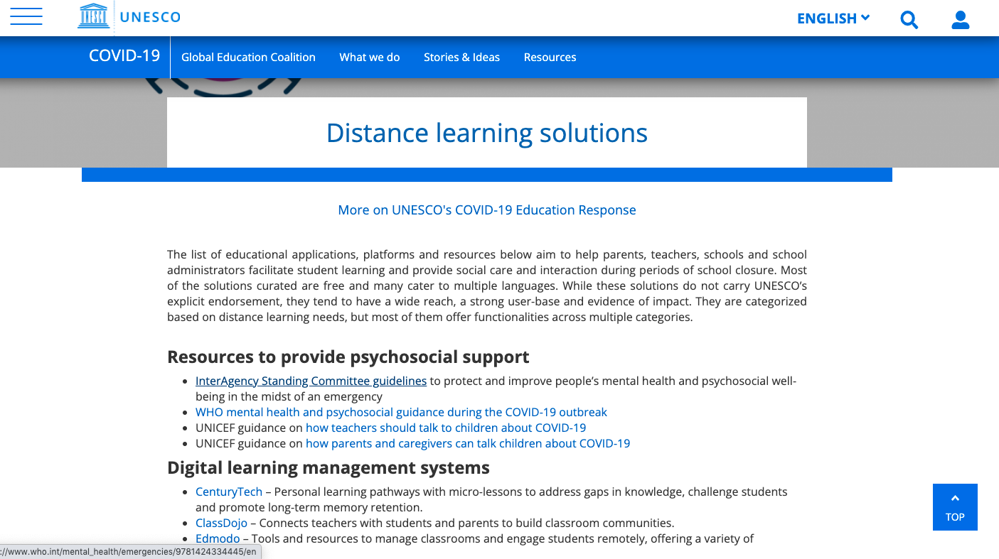
UNESCO (2020). Distance learning solutions. [Online; accessed 13-May-2020]. https://en.
unesco.org/covid19/educationresponse/solutions
Notes:
In response to this sudden massive transfer from traditional classroom learning to online learning , UNESCO took immediate action by publishing a long list of existing tools to facilitate distance education during the period of school closure.
It was a very long list of tolls for different education purposes.
Now the question is from all these possibilities how can we identify the best option.
Obviously we didn’t have time to checkout every tool on the list.

Slide 9
Google Trends Analysis in Distance Education
Aim: To explore if Google Trends search queries can be used as a proxy to quantify the popularity and public interest in various distance education options during and after the COVID-19 pandemic.
Google Trends: An open-source web analytics tool offering insights into internet search behaviour.
Provides a relative search volume scaled from 0 to 100, indicating interest relative to the highest point in the series for the chosen region and time.
A value of 100 indicates the peak popularity of a term within the specified time frame.
Notes:
This is actually the main motivation behind our research.
We wanted to check whether google ….
You are already familiar with Google trends.
We had several sessions on this.
Google trend….

Slide 10
Google Trends Analysis in Distance Education
Timeframe: December 2019 to April 2024
Key Questions:
What solutions have emerged to meet the demands of distance education during and post COVID-19? (Emergent Solutions)
Which distance learning solutions have gained widespread attention and public interest? (Public Interest)
Selected search terms based on UNESCO's list of distance learning solutions (UNESCO, 2020).
Concentrated on the education category to improve data relevance and accuracy (Vaughan & Romero‐Frías, 2014).
Avoided acronyms to prevent confusion, focusing on specific tools and techniques in the market (Vaughan & Romero-Frias, 2014).
Notes:
In this study, we restricted our search parameters to the time frame spanning from December 2019 to April 2024.
Through this study we aimed to answer two key questions: Q1…… Q2……
Choosing the right search term in google trends is very important .
We selected …
In this study we concentrated on …
We also avoided acronyms………. Because our focus was on specific tools….

Slide 11
Segmentation of Analysis
Digital learning management systems
Systems designed for basic mobile phone usage
Systems with strong offline fucntionalities
Massive Open Online Course (MOOC) platforms
Self-directed learning resources
Mobile reading apps
Collaboration platforms facilitating live-video communication
Tools for educators to create digital learning content
External repositories of distance learning solutions
Tools for Online proctoring
Psychosocial support
Notes:
We did our analysis under 11 subsegments
They represent diverse range of distance learning solutions.
This segmentation was mainly guided by the list of education tools published by the UNESCO in response ti COVID 19 Pandemic.
PAUSE: In most of these categories , they had proposed more than five tools
Then this gave us a problem.

Slide 12
Handling Google Trends Query Limitations
In Google trends, it is possible to search for only up to five queries at a time.
Under each segmentation, we entered up to five distance learning tools at a time and recorded their relative ranking scores.
An iterative pairwise comparison was used to identify tool with the highest relative ranking score during the study period.
Used this highest-ranked tool as a reference point for obtaining the relative ranking scores of other tools.
Notes:
The problem is,
With google trends it is possible to search …
And remember google trends provides a relative search volume scaled from 0 to 100.
Now the question is , how can we get a correct “relative” search volume when there are more than five tools to compare.
This is how we handled that limitation
Under each….

Slide 13

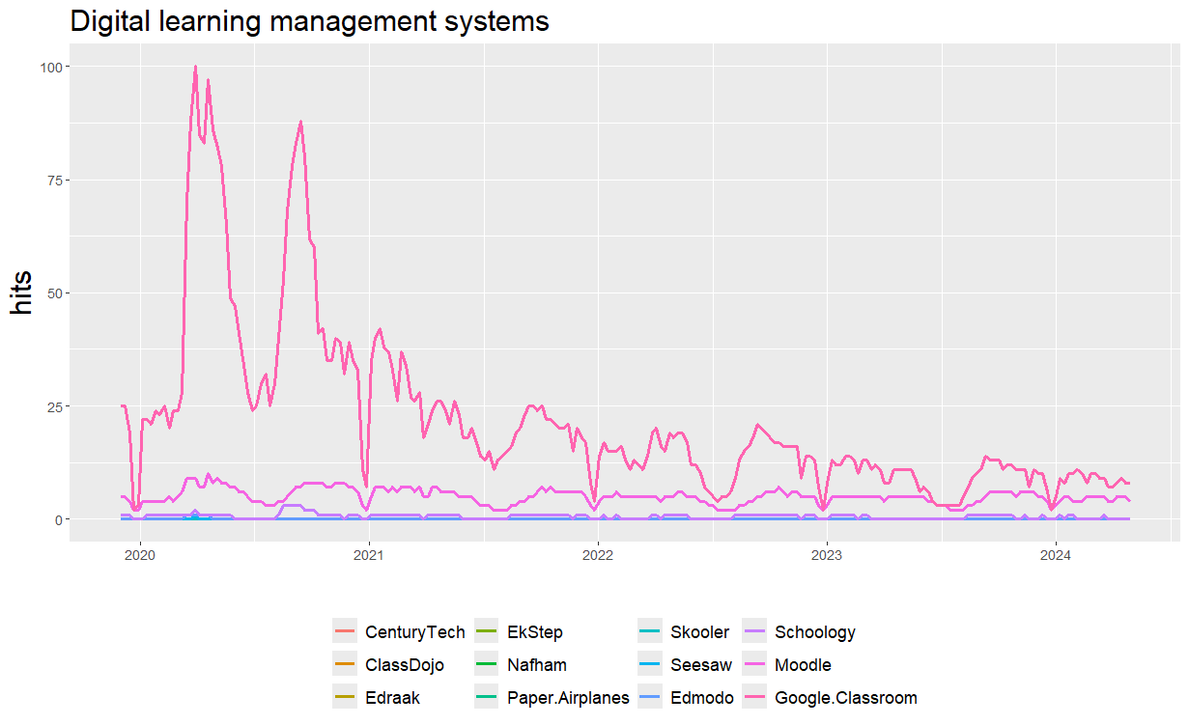
Image Source: https://www.didasko-online.com/wp-content/uploads/2022/09/LMS-and-learning-icons-with-man-using-computer-as-background.jpg
Notes:
This shows the public’s interest in digital leaning management systems.
Google classroom and Moodle have gained a lot of public attention

Slide 14

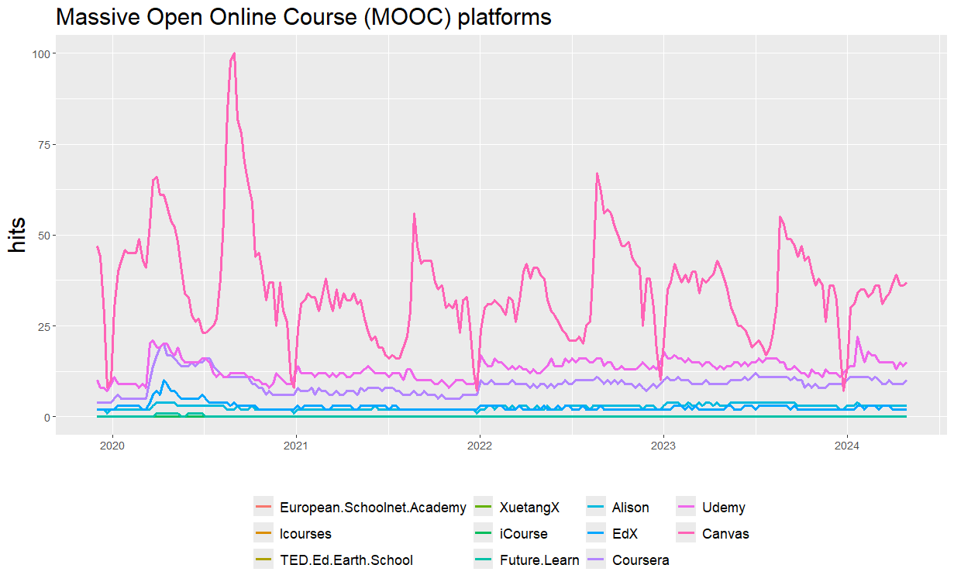
Image Source: https://www.intelligenthq.com/wp-content/uploads/2018/06/Online-course-certificates.jpg
Notes:
This shows the Public attention towards Massive Open Online Course platforms.
Canvas , Udemy and Coursera have gained a lot of attention during the study period.

Slide 15

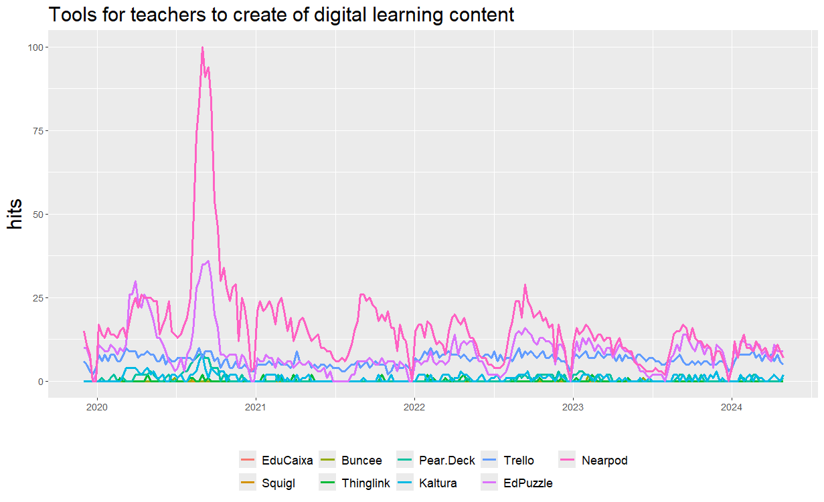
Image Source: https://www.linkedin.com/pulse/lack-training-teachers-use-new-technologies-why-our-education-/
Notes:
This shows the Tools for teaching to create of digital leaning contents.
Nearpad has gained more public attention compared to other options, specially during the covid 19 pandemic.

Slide 16

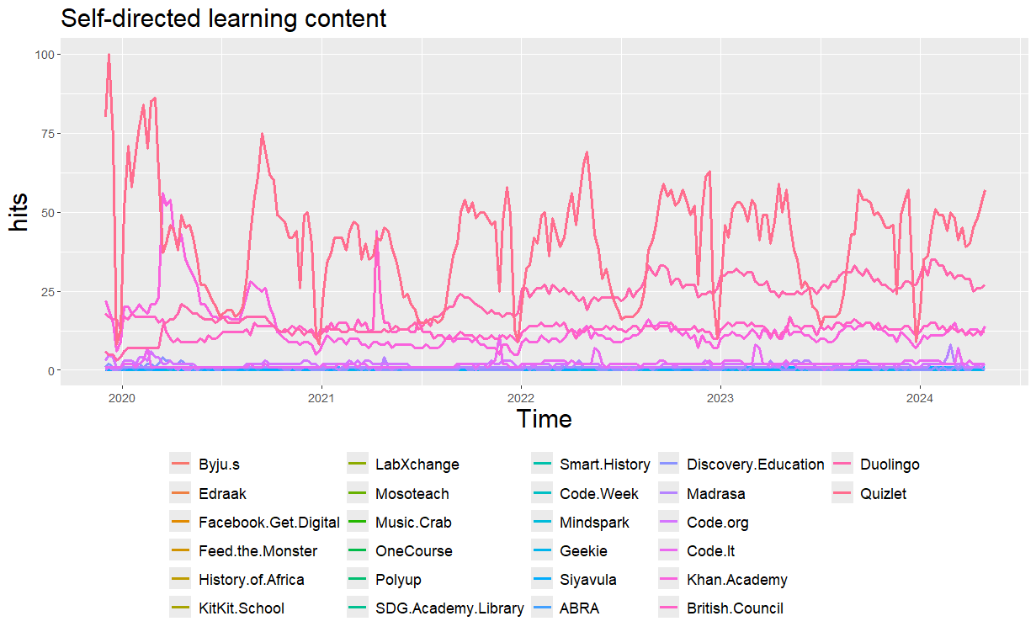
Image Source: https://easy-peasy.ai/ai-image-generator/images/self-directed-learning-unlock-educational-journey
Notes:
Self directed learning content
Again w ecan see a few dominant options , Quizlet and Duolingo

Slide 17

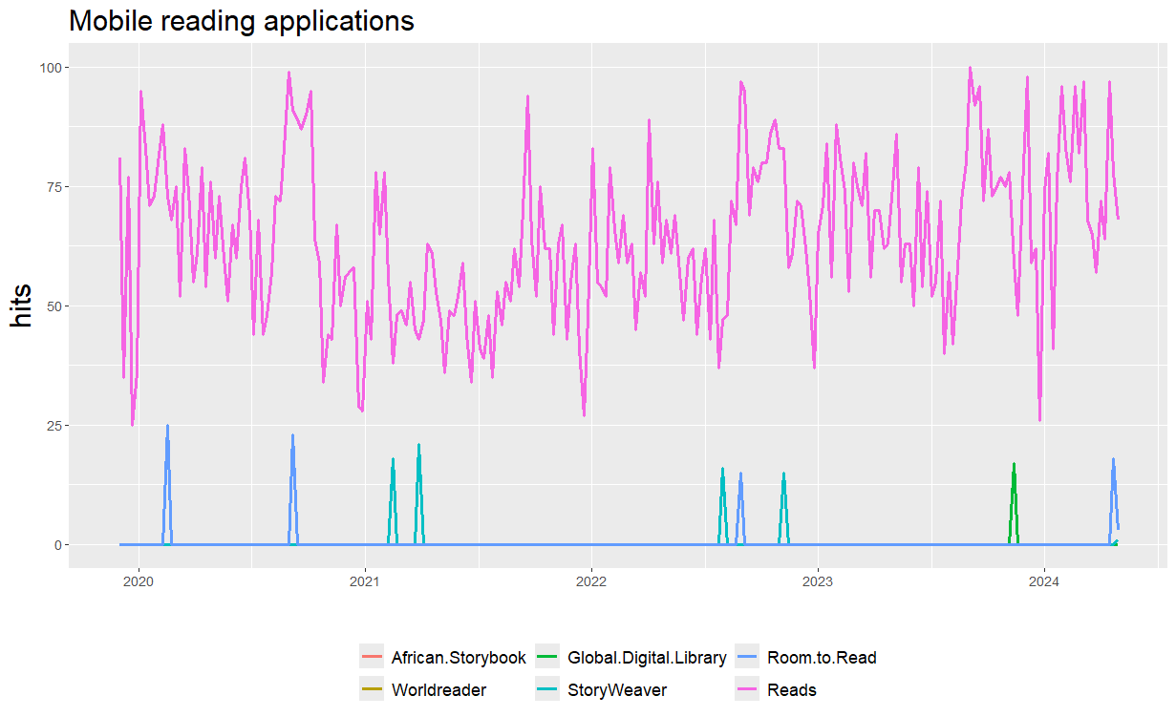
Image Source: https://beerconnoisseur.com/sites/default/files/blogs/2022/role_of_education_in_the_modern_world_of_technologies/remote-working-1024x681-1-900x599-1.jpg
Notes:
Mobile reading applications
We can see that Reads has gained consistent public attention throughout the study period, with no specific pattern related to the Covid 19 pandemic.

Slide 18

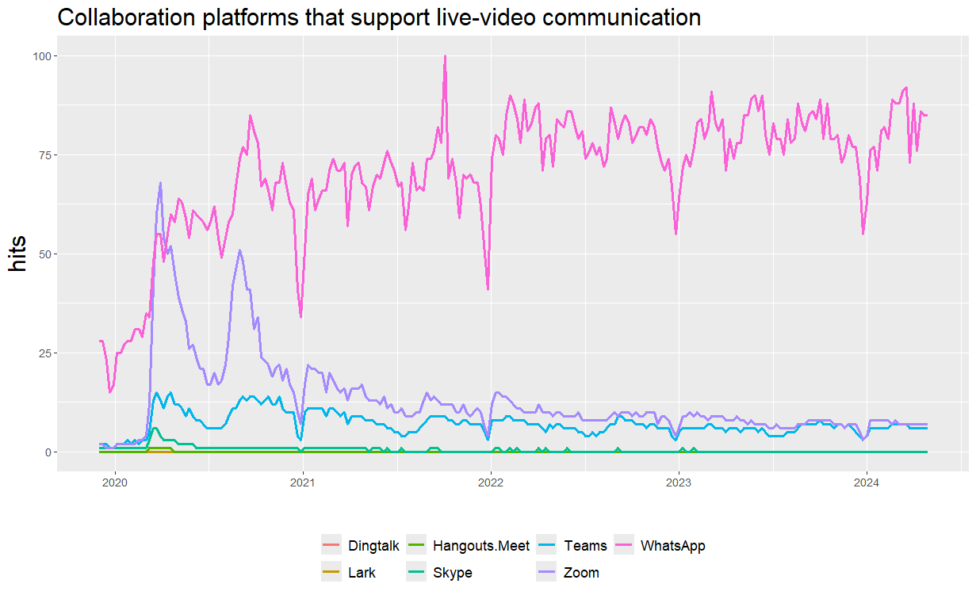
Image Source: https://s39613.pcdn.co/wp-content/uploads/2021/05/during-covid19-attractive-woman-gestures-during-virtual-meeting-with-picture-id1293927641.jpg
Notes:
Collaboration platforms…
As I mentioned earlier , we limited our google search queries to the education category.
Here zoom is the dominant tool at the start of the pandemic
However, WhatsApp shows a consistent increasing trend even after the covid 19 pandemic , although attention towards zoom declined after the pandemic,

Slide 19

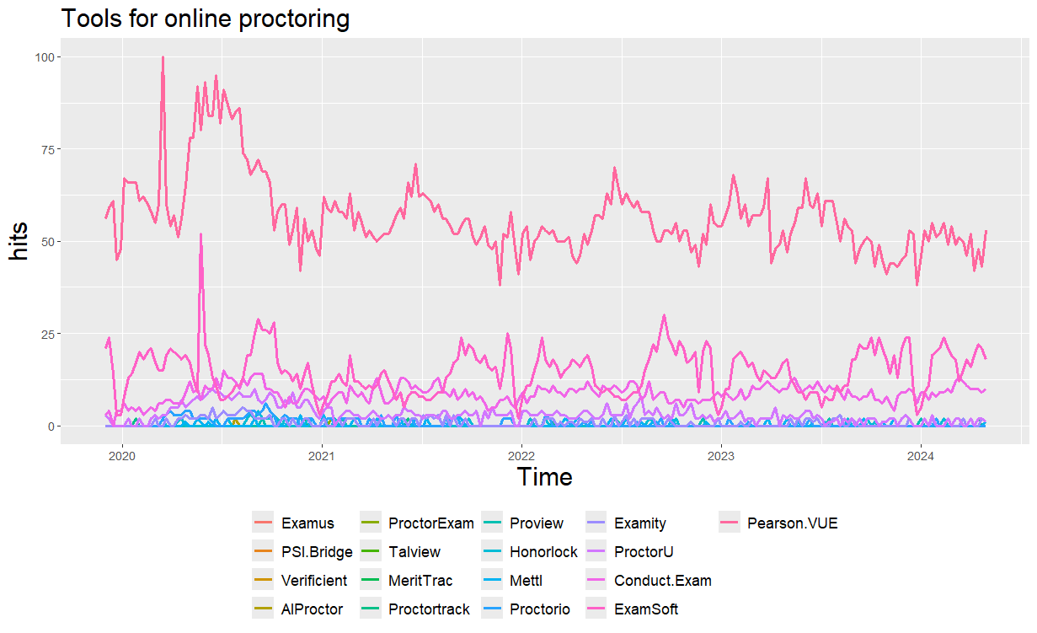
Image Source: https://cdn.elearningindustry.com/wp-content/uploads/2021/01/is-remote-proctoring-the-future-of-academia.png
Notes:
Tools for online proctoring.
This was significant challenge during the pandemic
Pearson VUE has gained more public attention compared to other options , specially during the Covid 19 pandemic.

Slide 20

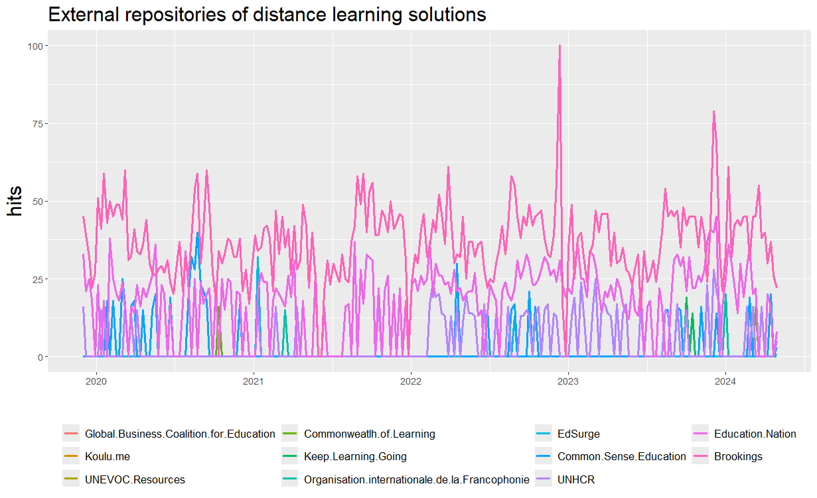
Image Source: https://www.languagemagazine.com/wp-content/uploads/2020/03/GettyImages-1174366520-300x174.jpg
Notes:
During the COVId 19 pandemic, categories such as External repositories of distance learning solutions.

Slide 21

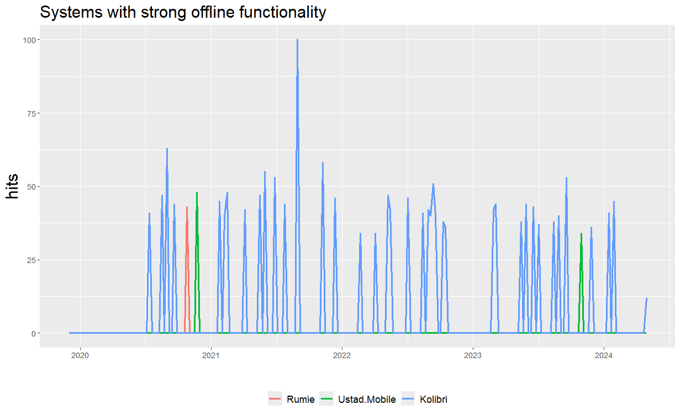
Image Source: https://medium.com/@i.vikash/designing-a-mobile-application-architecture-for-offline-use-e03e7731f4f2
Notes:
During the COVId 19 pandemic, categories such as External repositories of distance learning solutions,
Systems with strong offline functionality

Slide 22

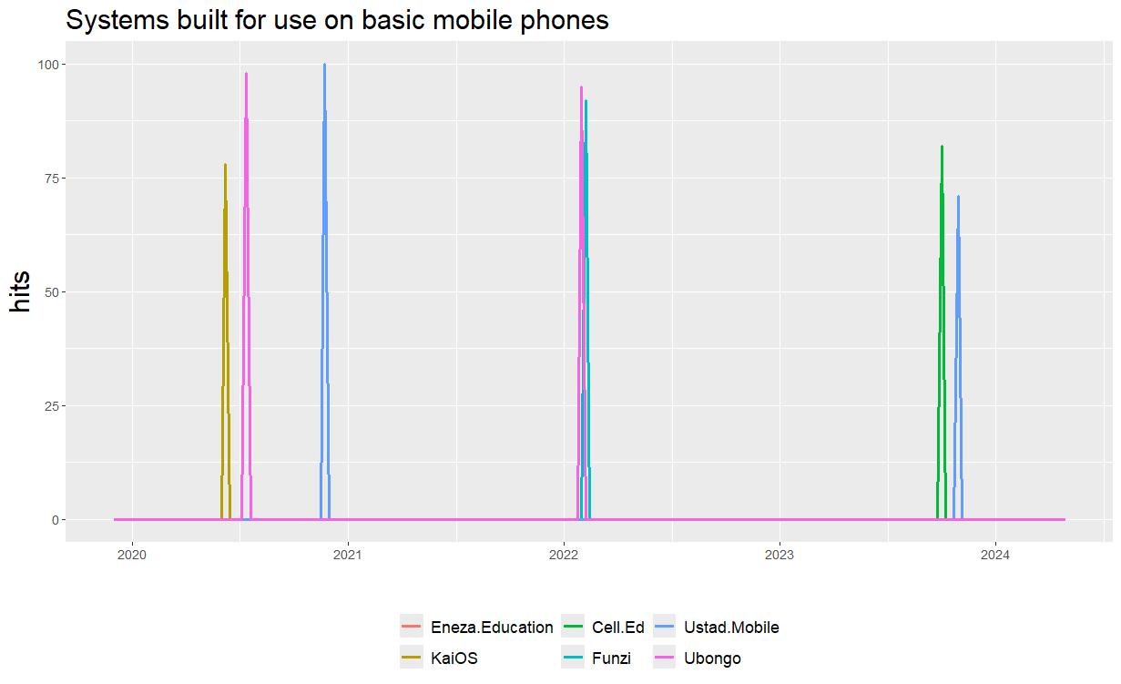
Image Source: https://elearningindustry.com/wp-content/uploads/2020/09/mobile-learning-what-is-it.jpg
Notes:
During the COVId 19 pandemic, categories such as External repositories of distance learning solutions,
Systems with strong offline functionality
Systems buit for use on basic mobile phones
Were not major concerns for the public compared to other categories.
However, this could be due to the sample bias, as these figures reflects only the search behaviour of internet users.

Slide 23
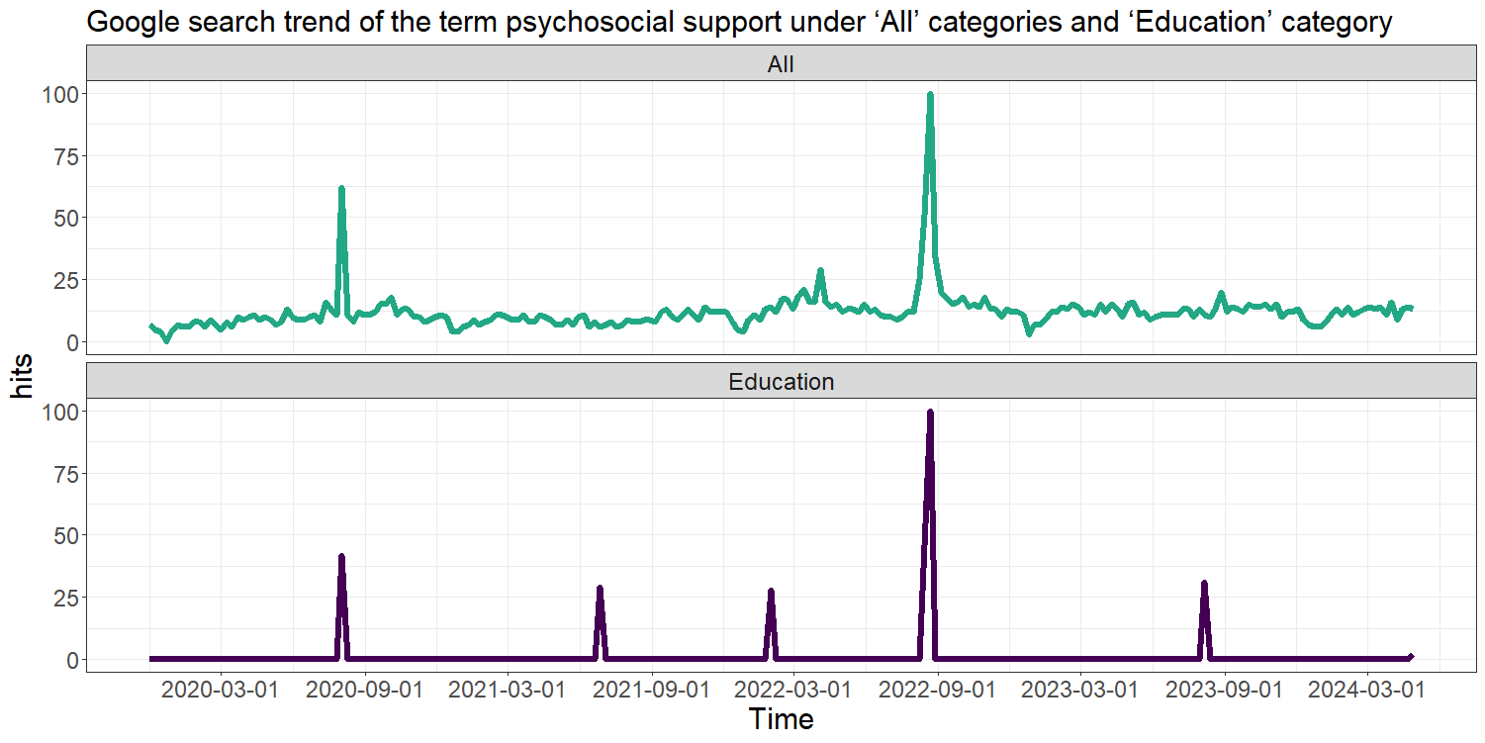
Notes:
Effective psychosocial support is very important for improving the mental health and overall well-being of students and teachers during a pandemic.
This is evident from the Google search trends.
The top panel here, shows the Google search trend of the term psychological support under “all” categories.
And the button panel shows the google trend behavior under the education category.
When it comes to this education category, We can see clear spikes in the third quarter every year, which align with academic breaks in most parts of the world.
And then this unexpected spike in the first quarter of 2022

Slide 24
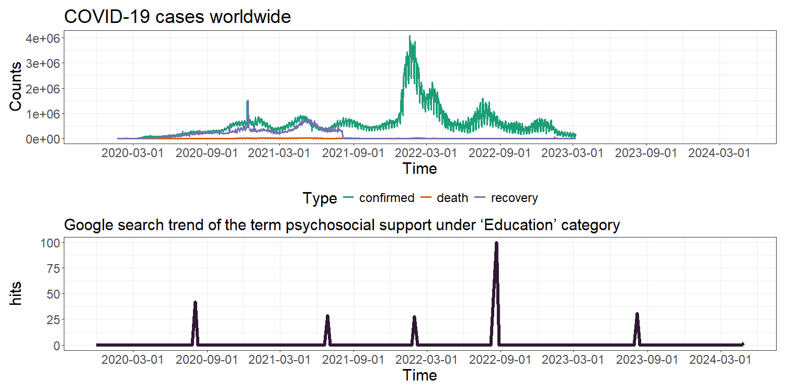
Notes:
And then this unexpected spike in the first quarter of 2022
Actually aligns with the global peak of the covid 19 cases.
So this shows that , analyzing secondary data in this manner is very important, as these characteristics may be overlooked due to increased engagement and communications between the students and the educators during school closures.

Slide 25
Main Contributions
Facilitates navigation through the multitude of market options available.
Enables informed decision-making with minimal time and effort.
Provides valuable information for identifying competitors and enhancing tool efficacy.
Guides developers and educational institutions to improve and innovate existing tools.
Highlights the critical need to address overlooked aspects of mental health support during academic breaks and school closures.
Notes:
With that let me summarise the main contributions of our study.

Slide 26
What Next ?
Popularity does not guarantee quality.
Future research should evaluate the efficiency and effectiveness of popular tools to ensure engaging online learning experiences.
Reflects search behavior of internet users only.
Further investigation at national and regional levels to understand the specific needs and challenges in different areas.
Further research should assess the accuracy, reliability, and coverage of Google Trends data to enhance its utility (Cebrián et al. ,2023)
Notes:
Our study quantified the popularity and public interest in distance education during the pandemic,
However, popularity does not guarantee quality.

Slide 27


Thank you
This work was supported in part by the RETINA research lab, funded by the OWSD, a program unit of the United Nations Educational, Scientific, and Cultural Organization (UNESCO).
Data and codes available at: https://github.com/pridiltal/CARMA2024_Analysis
Slides available at
Priyanga Dilini Talagala
PhD (Monash)
prital.netlify.app
pridiltal
Thiyanga S. Talagala
PhD (Monash)
thiyanga.netlify.app
thiyangt

Slide 29
Region wise tracking of COVID-19 caused school closures and re-openings
Source: UNESCO (2020). COVID-19 educational disruption and response. [Online; accessed 13-May-2020]. https://en.unesco.org/covid19/educationresponse

Slide 30
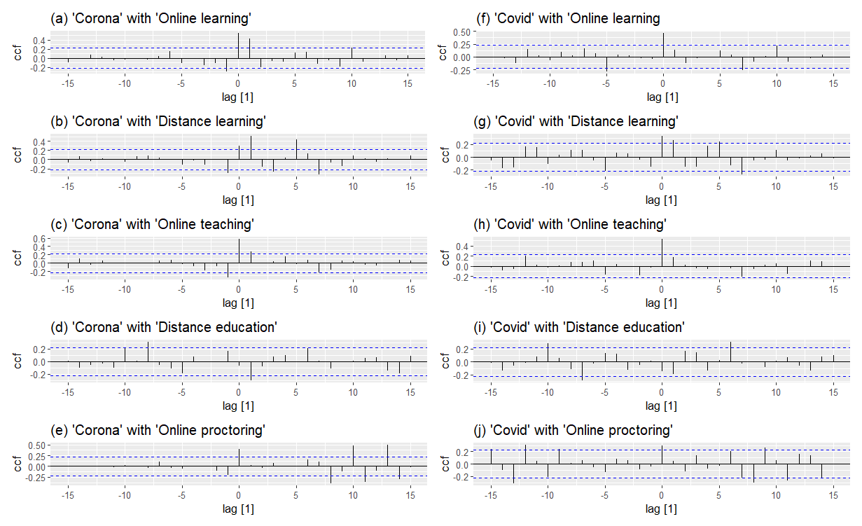

Slide 31
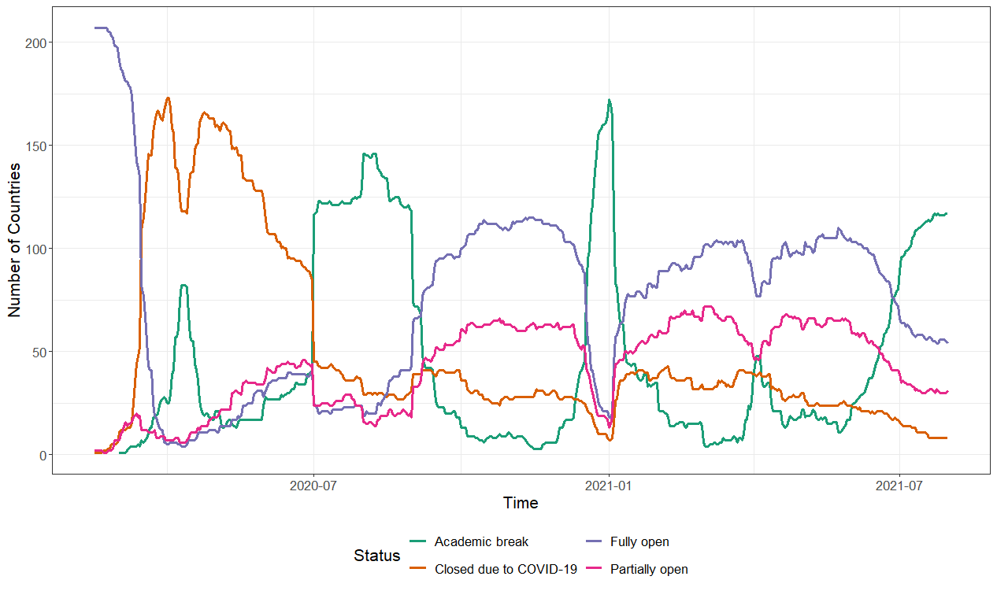
Global tracking of COVID-19 caused school closures and re-openings
Source: UNESCO (2020). COVID-19 educational disruption and response. [Online; accessed 13-May-2020]. https://en.unesco.org/covid19/educationresponse
Notes:
As we all know COVID 19 pandemic is one of the most impactful events of the 21 st centurary.
Among many sectors, education is one of the most affected sectors by COVID 19 Pandemic
This figure shows the evolution of global closures and reopening due to the COVID 19 Pandemic
The Orange line here represents the school closures due to covid 19 pandemic.
We can see that with he start of the Pandemic there is a near total closure of schools all around the world

